Slide 1



<IT is our nature>
Code Europe

Slide 2
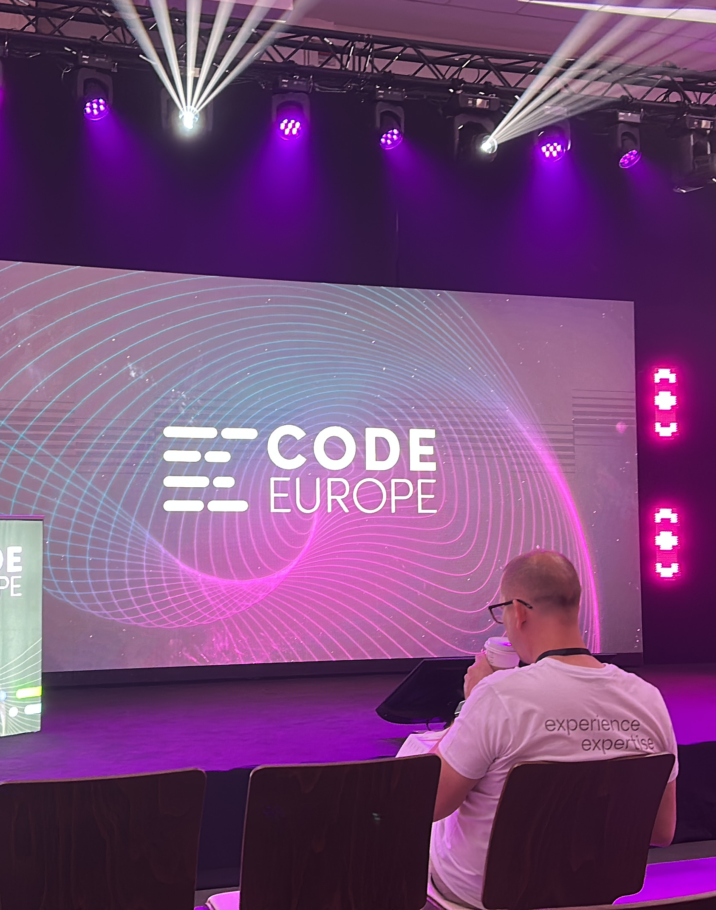
Code Europe

Slide 3
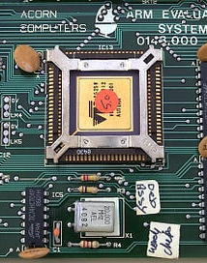
Exploitation on ARM architecture

Slide 4
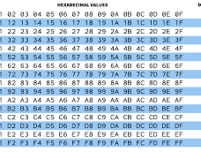
Exploitation on ARM architecture
ARM architectuur
Assembly
Hex instructie set
Manipulatie van de instructieset
Input custom set
Root toegang

Slide 5
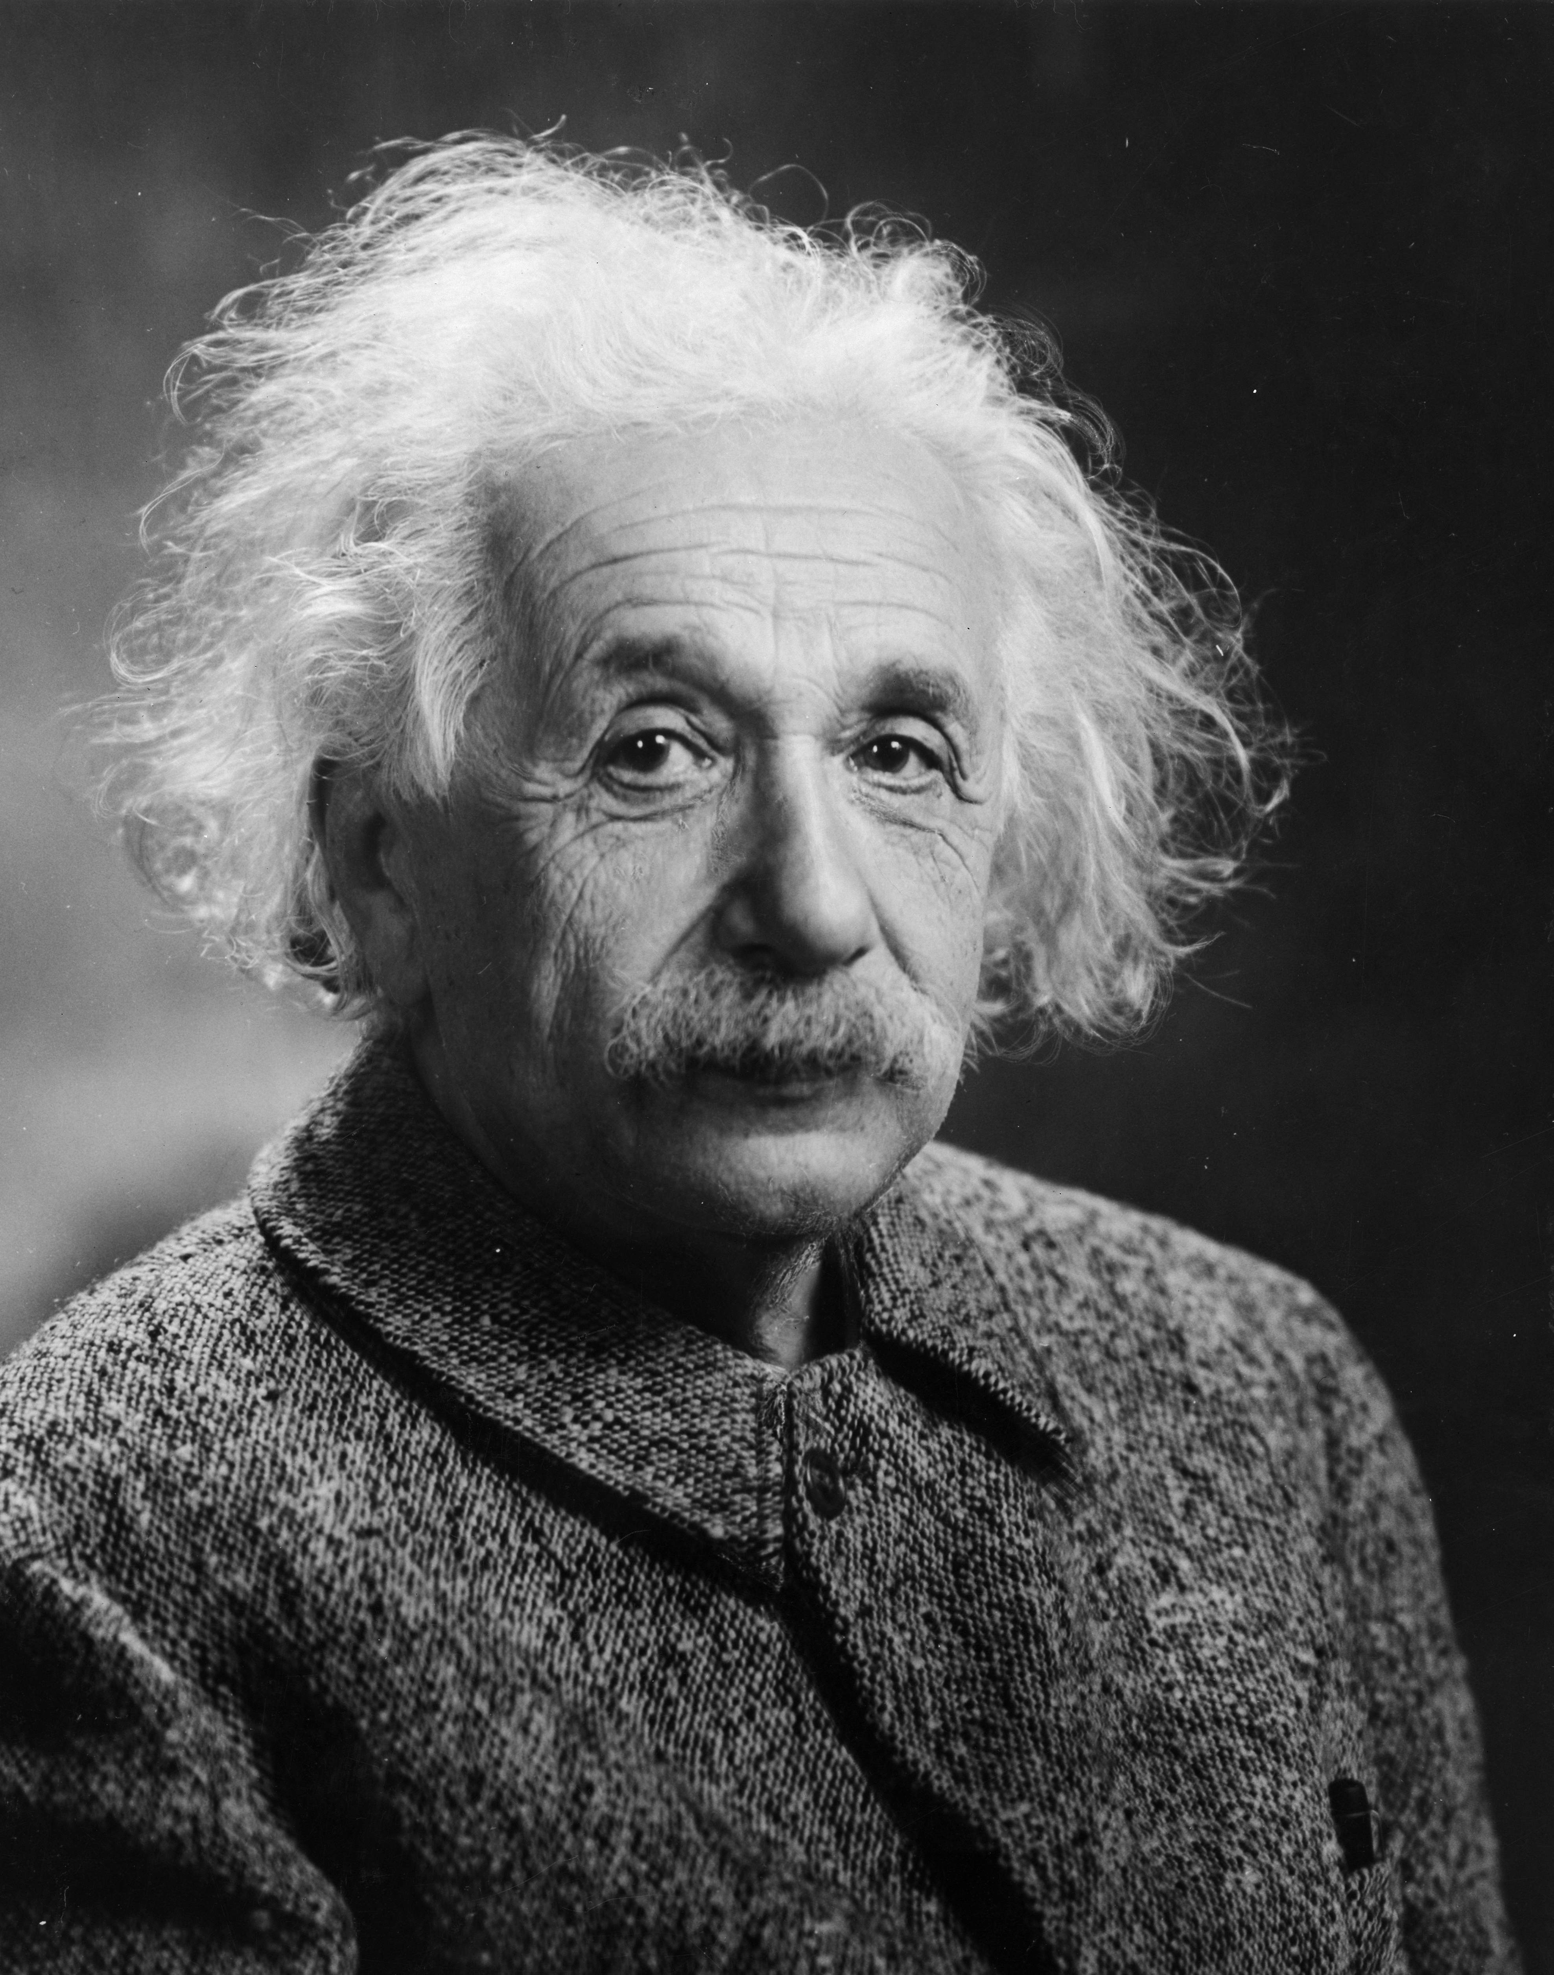
Debug like a scientist

Slide 6
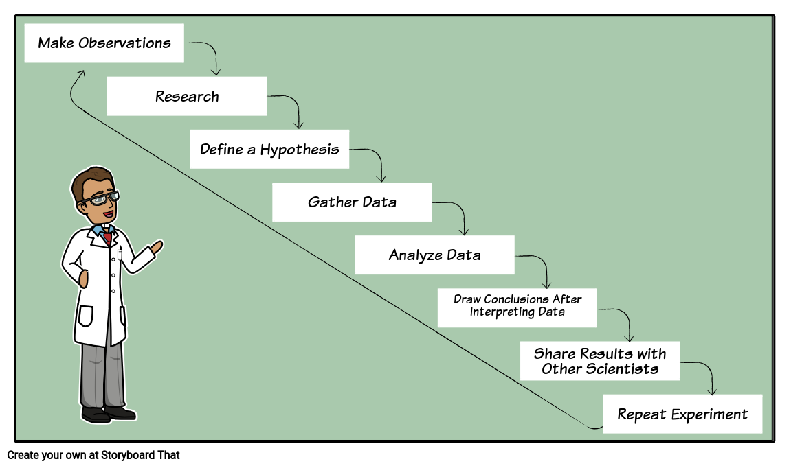
Debug like a scientist

Slide 7
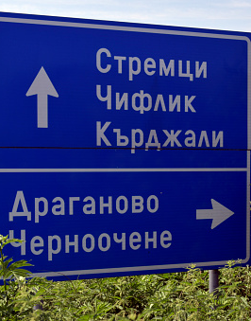
There is no such thing as Plain text
Wat is de reden dat ASCII bestaat?
Wat waren de tekortkoming?
Hoe zijn we hier gekomen?
Fun thing:
https://codewithrockstar.com/

Slide 8

Java 25 (What happened from 22 till 25)
Wat is de reden dat ASCII bestaat?
Wat waren de tekortkoming?
Hoe zijn we hier gekomen?
Fun thing:
https://codewithrockstar.com/

Slide 9
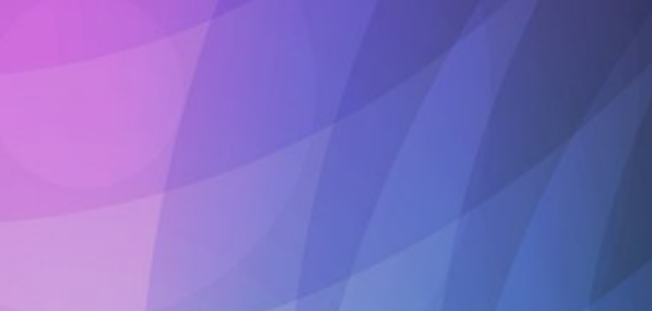
Java 25 (what happened from 22 till 25)
Module imports (JEP 511)
- import module <module_name>
Simplified Main (JEP 512 / 330)
void main() {}

Slide 10
Java 25 (what happened from 22 till 25)
Constructor (JEP513)
class Test extends somethingAwesome {
public Test () {
// prologue
super();
// epilogue
}
}

Slide 11
Java 25 (what happened from 22 till 25)
Ahead of time computation – Java Performance (JEP 483 / 514 / 515)
Java performance is good (can rival C(++))
-> Downsides to java slower startup/warmup phase
-> Training runs
-> Project Leyden (AOTCache)
-> Use this as a initial state
Compact object headers (JEP519 / 450)

Slide 12
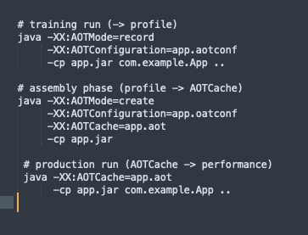
Java 25 (what happened from 22 till 25)
Ahead of time computation – Java Performance (JEP 483 / 514 / 515)
How does it work:
Benchmark:
Spring Petclinic
~40% startup reduction
(AOT cache size of ~130mb)

Slide 13

Conclusions

Slide 14
Code Europe

Slide 15

Krakow

Slide 16
Links
Code europe:
https://www.codeeurope.pl/en/
Vids:
https://www.youtube.com/@CodeEurope/videos
Nicolas Parlog:
https://nipafx.dev/
Dylan Beattie:
https://dylanbeattie.net/
https://www.youtube.com/watch?v=ajfb5LSbQVM

Slide 17

Vragen… That’s the question?

